Slide 1
Employee Salaries Analysis and Regression Model

Slide 2
Project Overview
Analysed employee salary dataset.
Cleaned data, visualized key insights, and built regression models.
Predicted employee salaries using different machine learning algorithms.

Slide 3
Libraries Used
pandas
numpy
seaborn
matplotlib
sklearn

Slide 4
Data Cleaning
Null Values:
Since there is only less than 1% of null values only there in the dataset. Checked and removed rows with null values.
Duplicates:
Identified and removed duplicate rows (more than 5%).

Slide 5
Data Visualization AND ANALYSIS
Distribution and Outliers:
Box plots and histograms for numeric columns.
Since this is salary and pay It is possible to say some employees may get high salary when comparing to others. So no need to treat the outliers.
Most of the employees get salary from 50,000 to 1,00,000

Slide 6
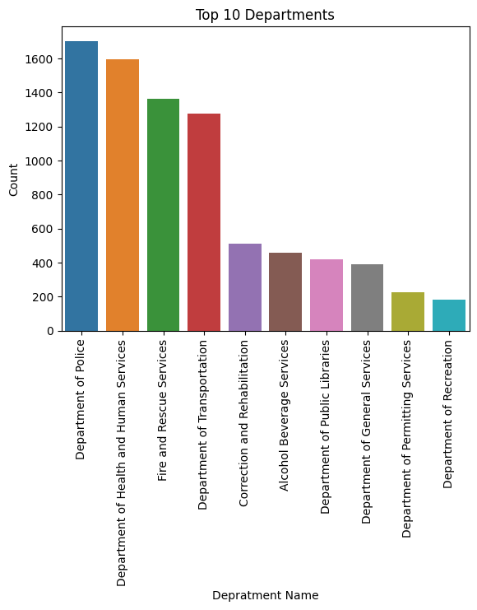
Department Analysis:

Slide 7
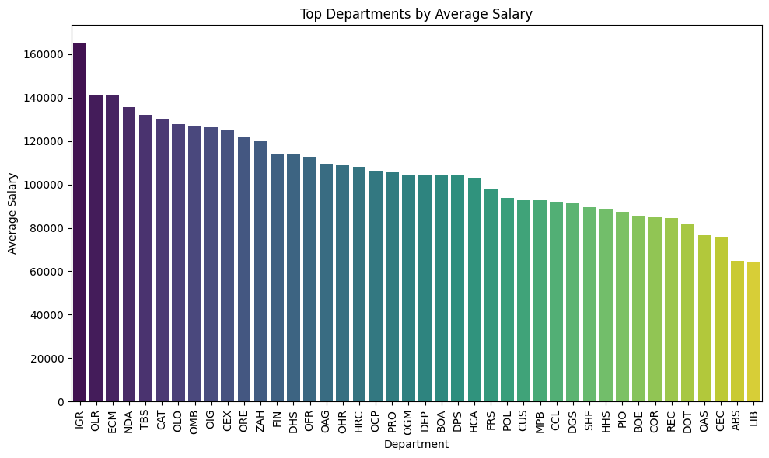
The average salary varies based on the department
Employees in the department of IGR, OLR and ECM getting more salary than other departments.
Employees in the department of CEC, ABS and LIB getting the least salary than other departments.

Slide 8
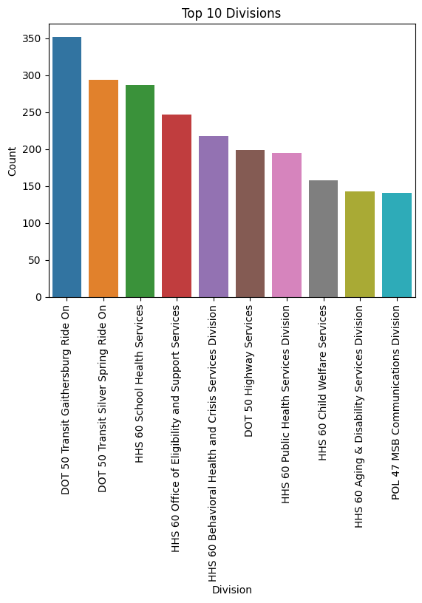
TOP 10 DIVISIONS EMPLOYEES WORK ON

Slide 9
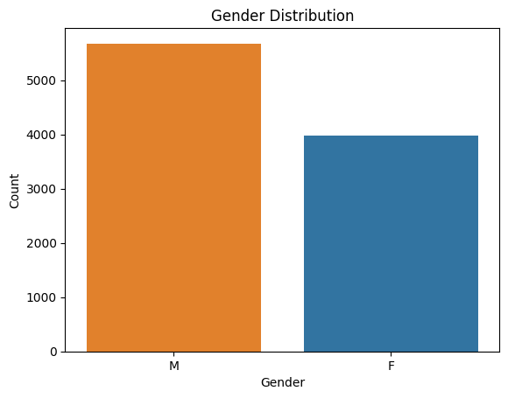
Gender Distribution and Pay Gap
No of male employees are 17 % higher than Female employees

Slide 10
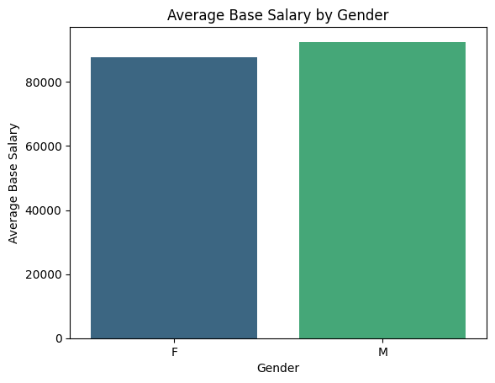
Salary of male employees slightly higher than Female employees

Slide 11
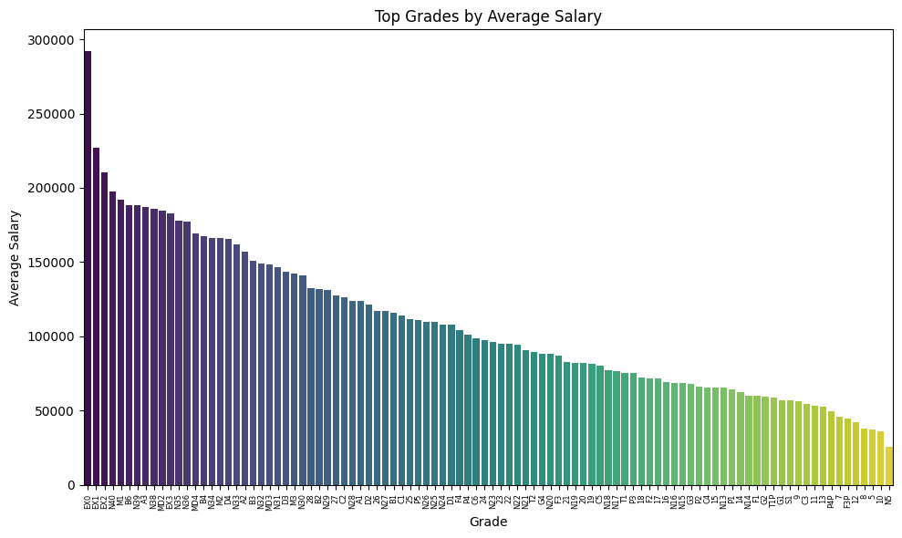
Grade Analysis
Salary of an employee varies based on Grade
EX0 EX1 EX2 are the highest paid grades whereas 5,10 and N5 are the least paid grades.

Slide 12
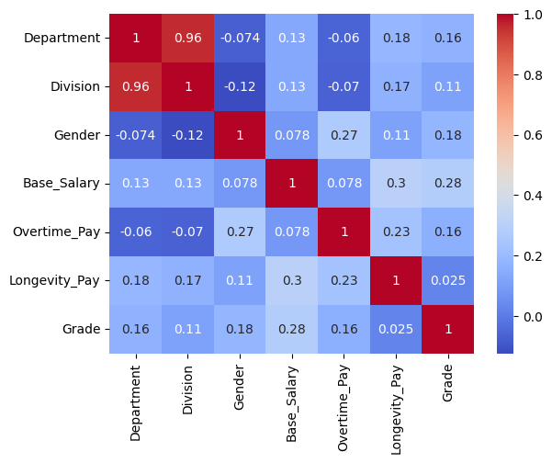
Correlation Analysis
Heatmap for feature correlation
No independent feature has a high correlation with the dependent feature.
The Department attribute has a high correlation with Division.

Slide 13
Model building
Regression Models
Linear Regression
Decision Tree Regressor
Random Forest Regressor
Gradient Boosting Regressor

Slide 14
Model Evaluation Metrics
Mean Squared Error (MSE)
Root Mean Squared Error (RMSE)
Mean Absolute Error (MAE)
R-squared (R2) Score

Slide 15
Insights
Decision Tree Regressor:
Higher R2 score for training data but lower for test data when compared with Random forest model.
Random Forest Regressor:
Good R2 score for both training and test data, indicating better generalization

Slide 16
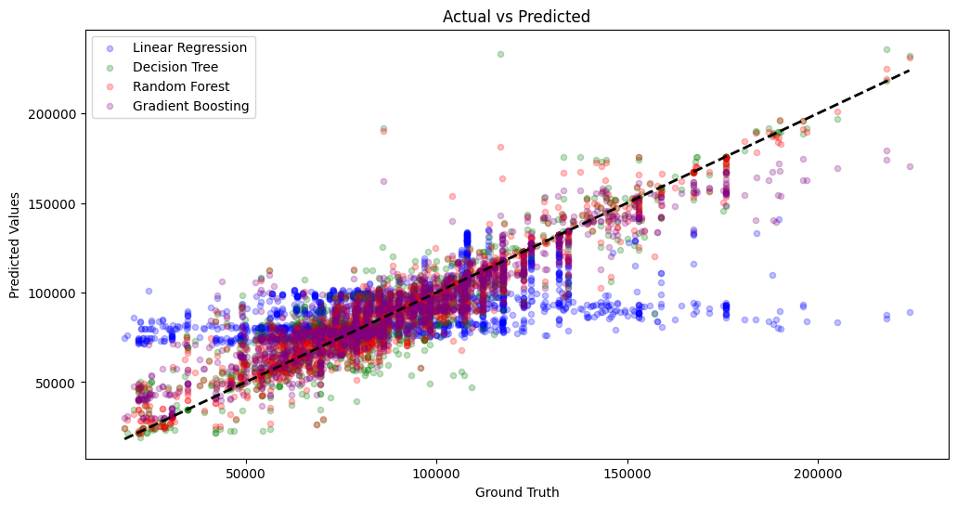
Model result

Slide 17
Values of test data predicted by the Random Forest model is closer to the actual values when comparing to the other models.
Random Forest Regressor Results:
Training Data Metrics:
R2 Score: 0.96
Testing Data Metrics:
R2 Score: 0.89

Slide 18
Thank you !

